Slide 1
Kahoot follow up instructions
In order to get access to the Team Cybersecurity: Defenders game (done over lunch on Tues. on 5/21/1):
1) signup with a username of your university email for your own account at https://kahoot.com/
Kahoot! is a game-based platform that makes learning awesome for millions of people all over the world. Sign up to create and play fun quiz games!
2) email to pamela.schmidt@washburn.edu
to request sharing of Cybersecurity Defenders Game, within www.kahoot.com
3) once you see shared version in your kahoot account, then you can copy it and change it, and /or run it yourself.

Slide 2
Digital Badges
Kimberly Swanson Church, Ph.d.
University of Missouri Kansas city

Slide 3
The Decade of AIS
Technology is the future for accountants, but not without risk
AccountancyAge, 2018
The Impact of Disruptive Technologies on Accounting and Auditing Education: How Should the Profession Adapt?
CPAJournal, 2018
The profession’s biggest challenges
AccountingToday, 2018

Slide 4
The future has risk
Cybersecurity Poses Challenge to Accountants
AccountingToday, 2015
Cybersecurity: A new engagement opportunity
Journal of Accountancy, 2017
The Why, What and How of Cybersecurity for Accountants
CPATrendLines, 2018

Slide 5
Cybersecurity Makes the top 10 list
Executive Perspectives on Top Risks 2019
2019 CIO Survey Report
Ten top concerns for U.S. compliance officers in 2019
SECURITY BREACHES: ARE YOU READY? (2019)

Slide 6
Cybersecurity Makes the top 10 list
Emerging Issues (2019)
Key Cyber Security Considerations For 2019
Cybersecurity – our Latest Thinking (2019)
US CEO agenda 2019

Slide 7
One approach to embrace the future
Digital Badges
set goals
motivate behaviors/learning
represent achievements
communicate success
signify community
[can have a] significant impact
A digital badge is part of the digital credentialing ecosystem that serves both as recognition of learning or achievement AND digital proof of that accomplishment.
https://elearningindustry.com/guide-to-digital-badges-how-used

Slide 8
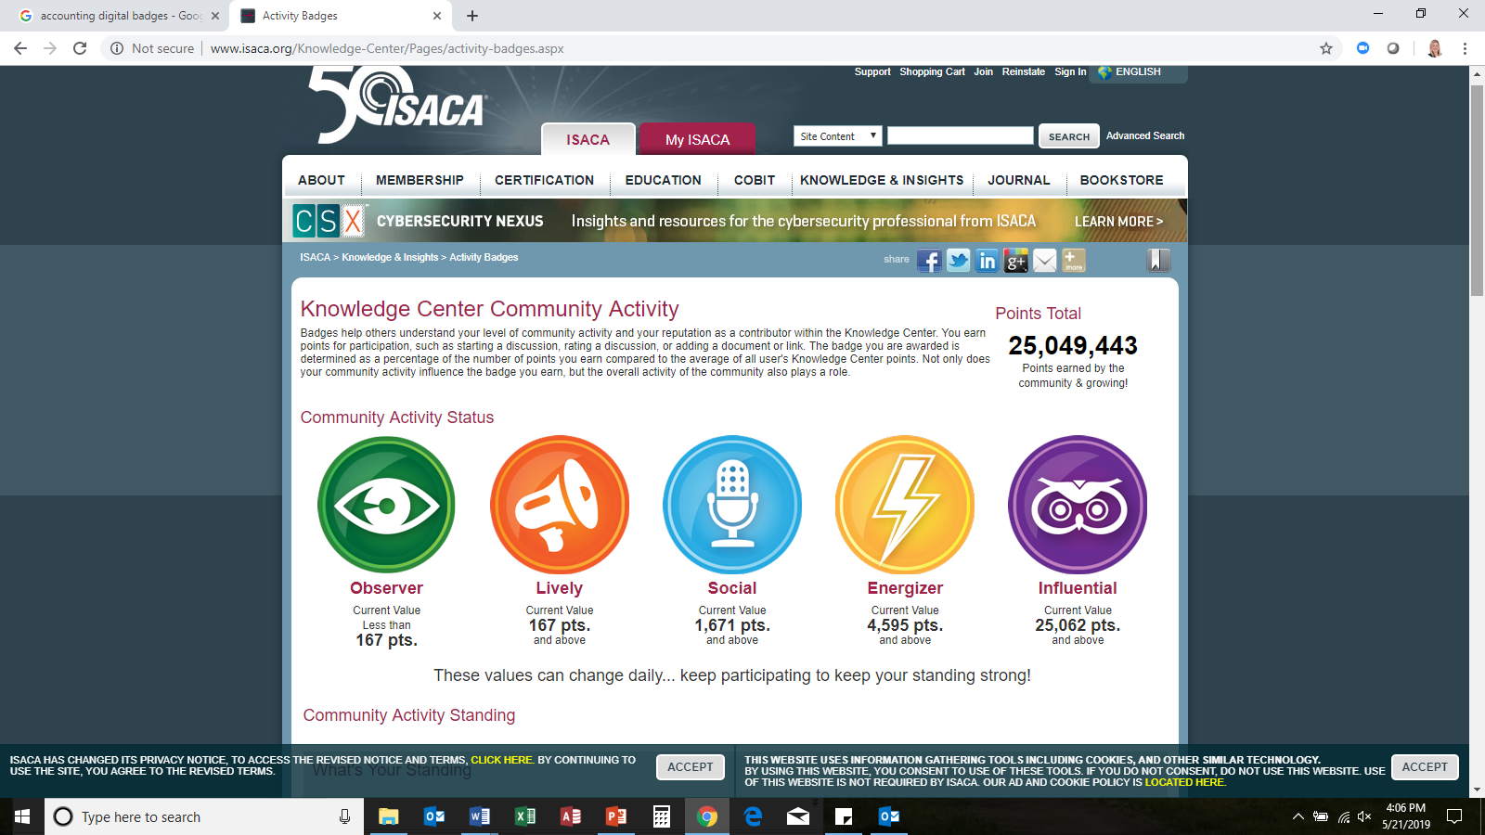

Slide 9
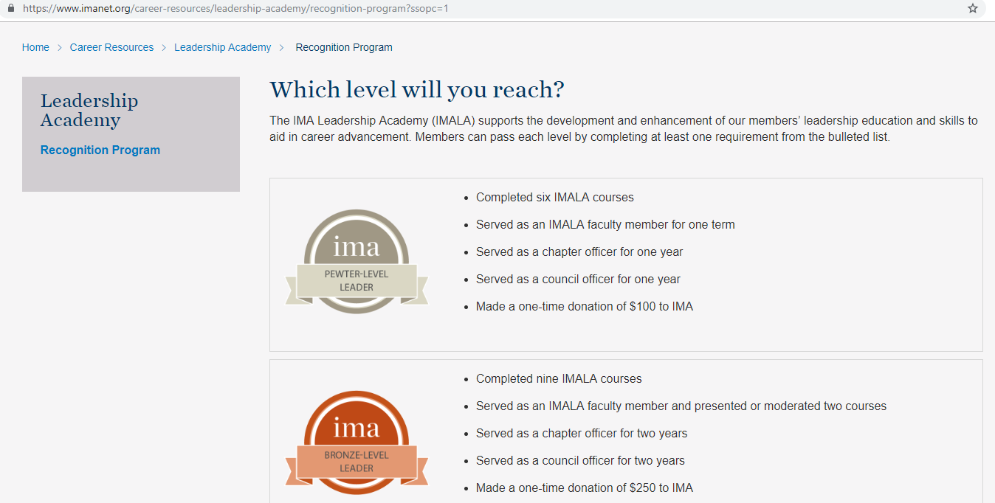

Slide 10
Skills based badges
Watch a series of videos or complete a set of materials that collectively make up a course
Answer questions along the way to identify strengths and gaps in knowledge
Demonstrate a specific level of understanding and competency in a subject
Badge is awarded
Additional badges are issued based on varying levels of mastery
Khan Academy

Slide 11
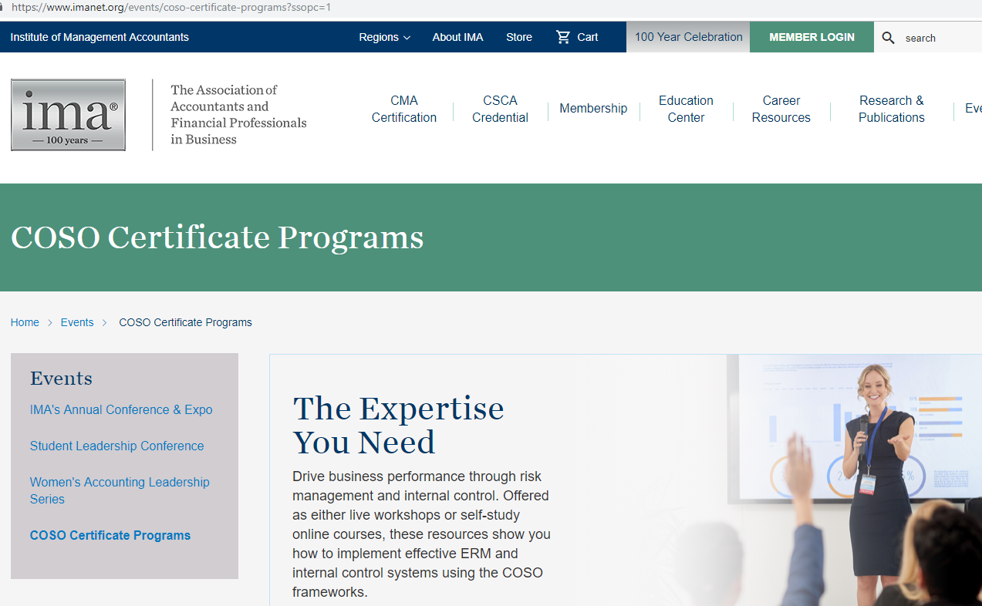

Slide 12
Issues with badging in education one in five institutions now offers digital badges or micro-credentialing (FORBES 2019)
Manually issue badges
Lack authentic evidence
Issue randomly
Expect students to manually claim
Hiding badges – LMS

Slide 13
Advantages of association badging
Membership: members range from students to new hires to seasoned veterans.
Competency Models: defined skill framework
Training: members used to learning content for formal continuing education credits,
Existing Technology: robust technology ecosystem to support rapidly changing skills-based training and digital badges.
Brand Recognition: center of the industry with reputation for awarding professional credentials
Agile: ability to quickly respond to demand
https://talentedlearning.com/how-associations-bridge-skills-gap-digital-badges/

Slide 14
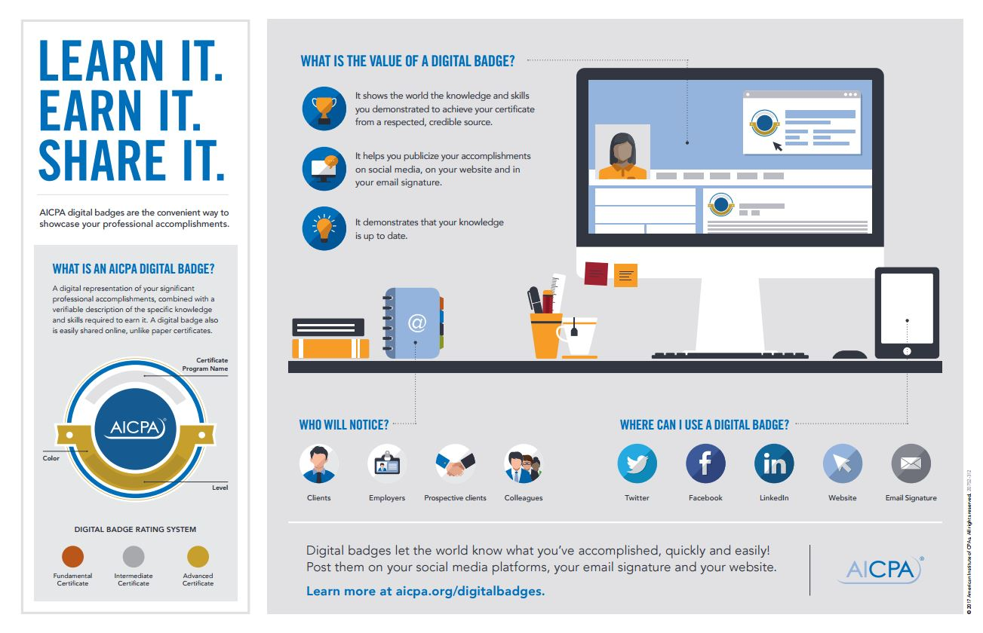

Slide 15
AICPA Digital Badges for faculty and students

Slide 16
AICPA Digital Badges for faculty and students

Slide 17
Cybersecurity fundamentals

Slide 18
Cybersecurity fundamentals

